Slide 1

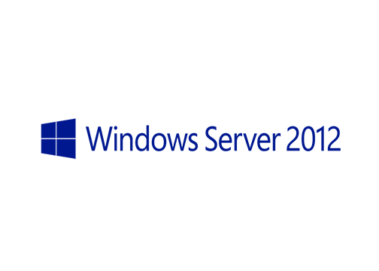
MegaSeries
Configure Hyper-V Replica with Powershell

Slide 2
Info
Replica is a technology that replicates a virtual machine to another Hyper-V host to have a copy of it in case of a disaster
Replication can be done at a time interval from the following: 30 seconds, 5 minutes and 15 minutes
Additional recovery points can also be saved (number of recovery points can be set); VSS snapshots can also be taken
Failovers to the replica ca be done and depending on the scenarios they can be: Test failovers, Planned failovers and Unplanned failovers

Slide 3
https://www.youtube.com/channel/UCcZ-jLbPwNr8E_v9-65n8Iw https://github.com/itknowledge4

